Slide 1
Rapid visual decision making for reach movements
Clara Kuper, PhD student
Active Vision and Cognition Colloquium

Slide 2
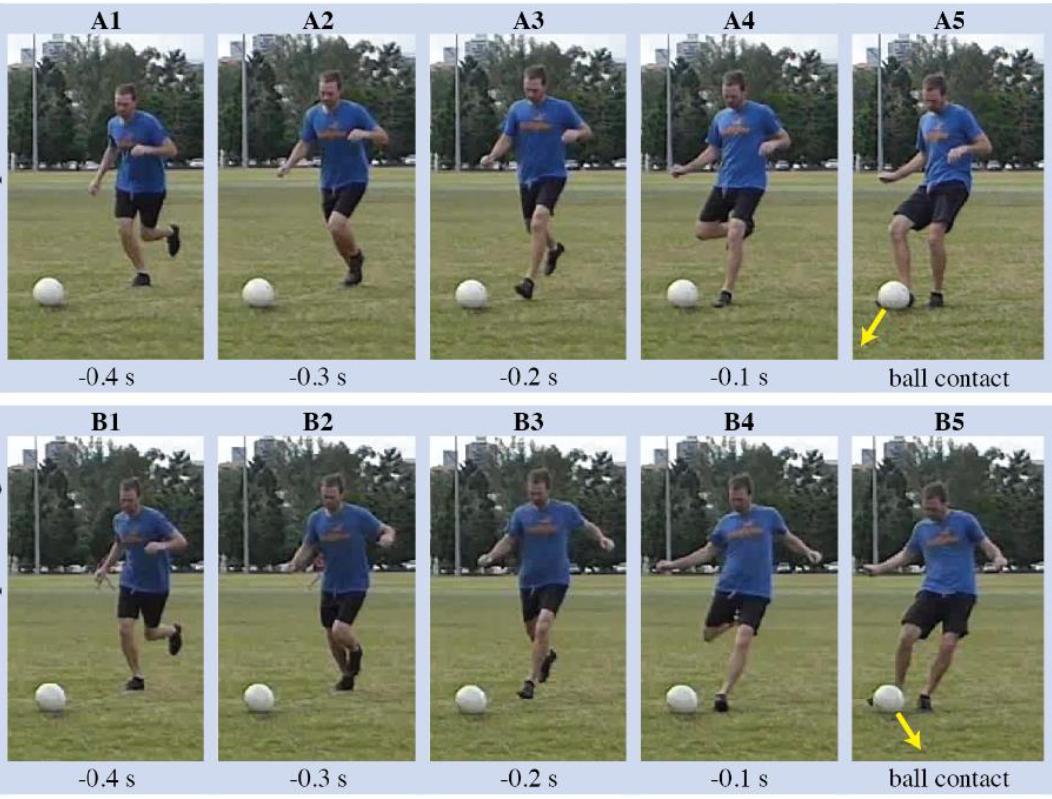
The Goalkeeper
Hunter et al. 2018

Slide 3
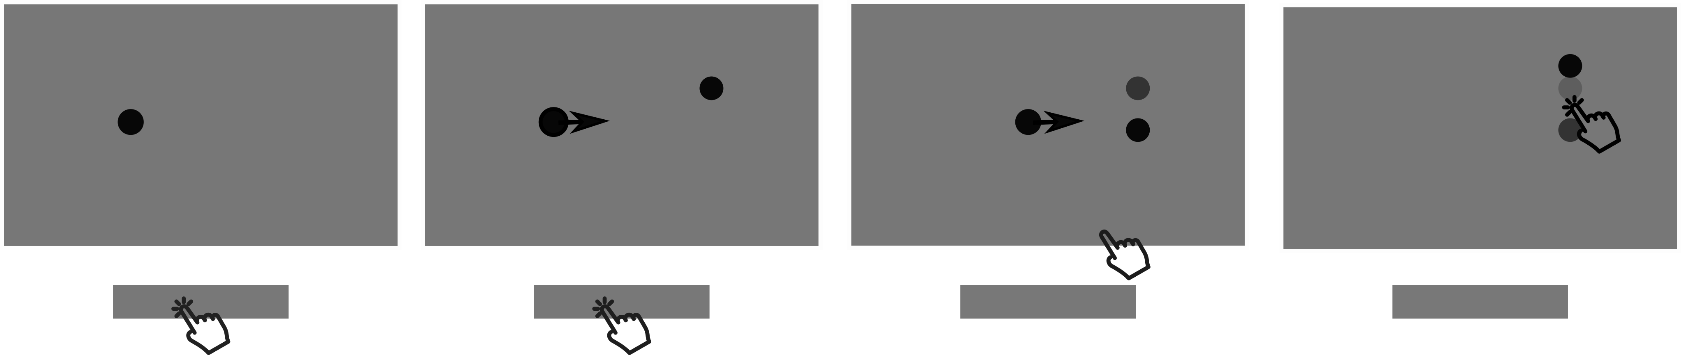
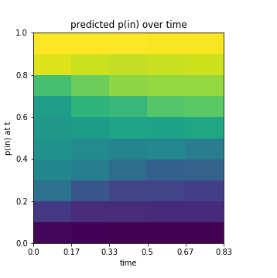
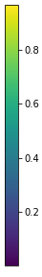
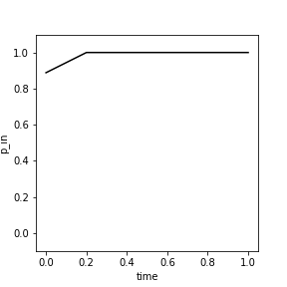
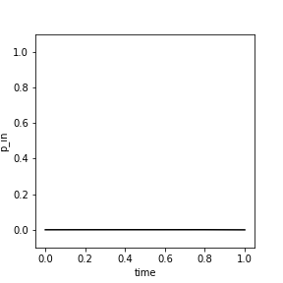
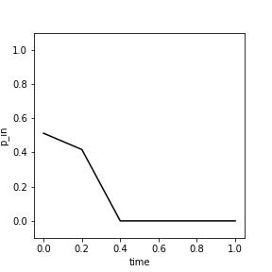
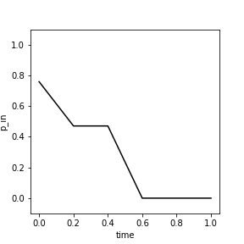
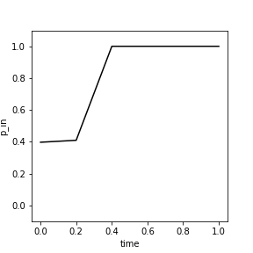

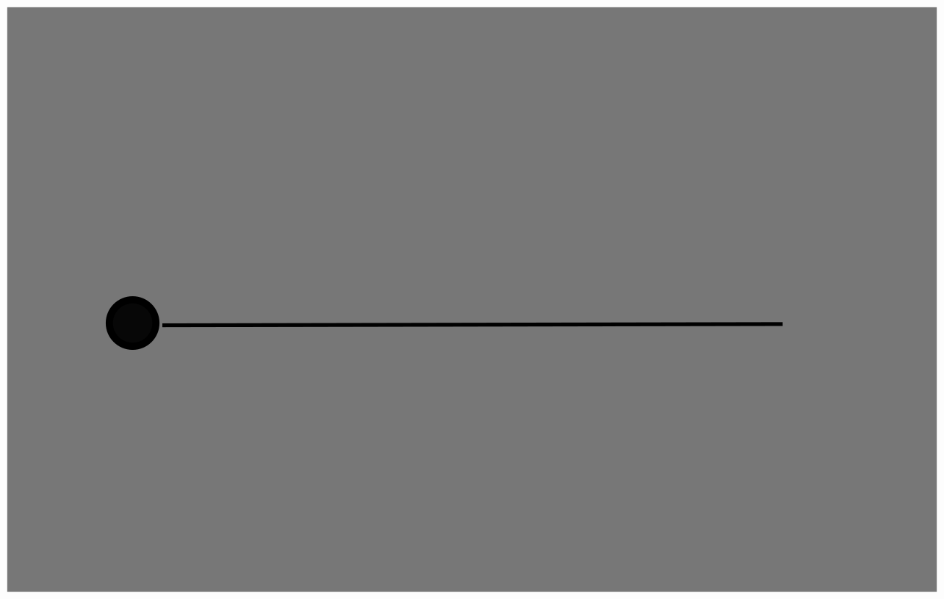
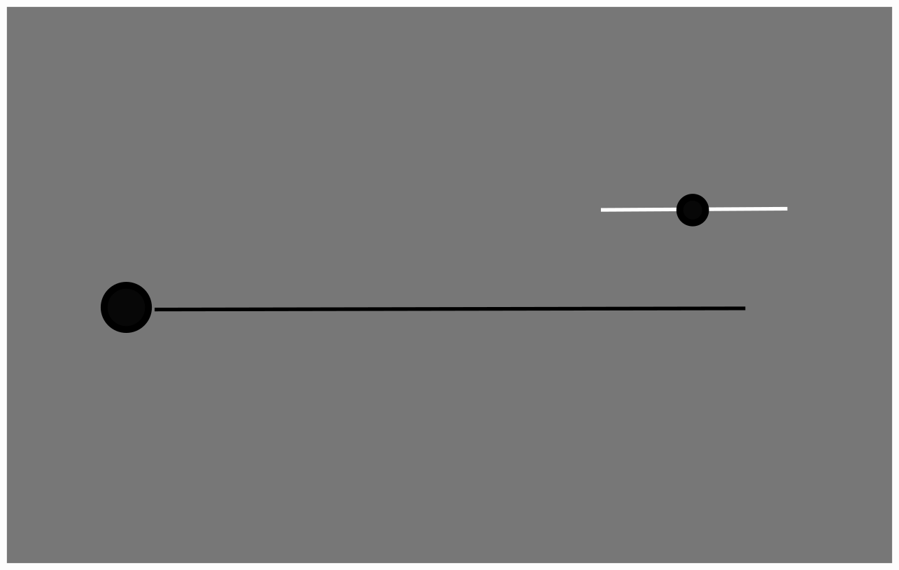
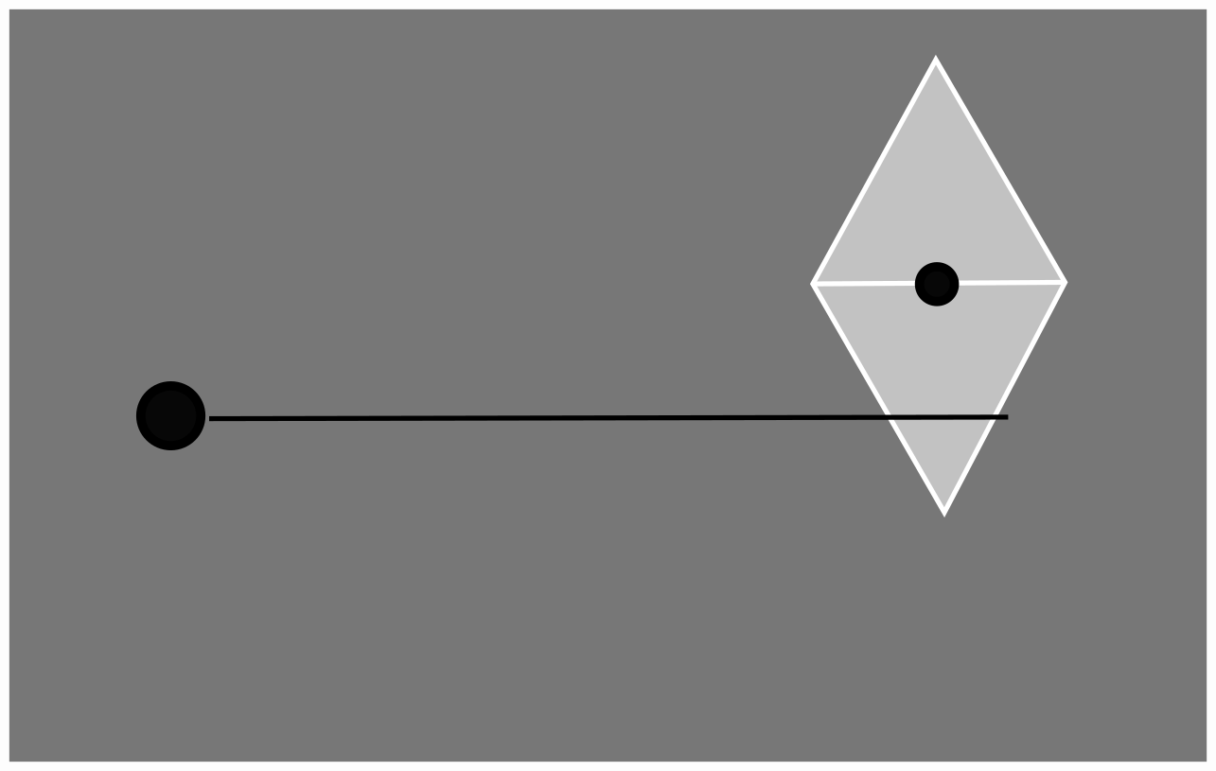
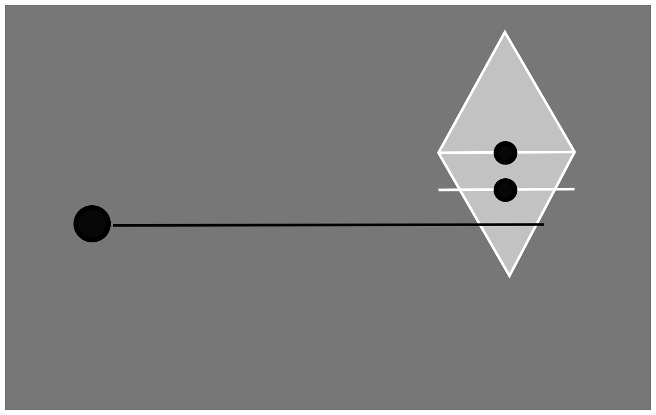
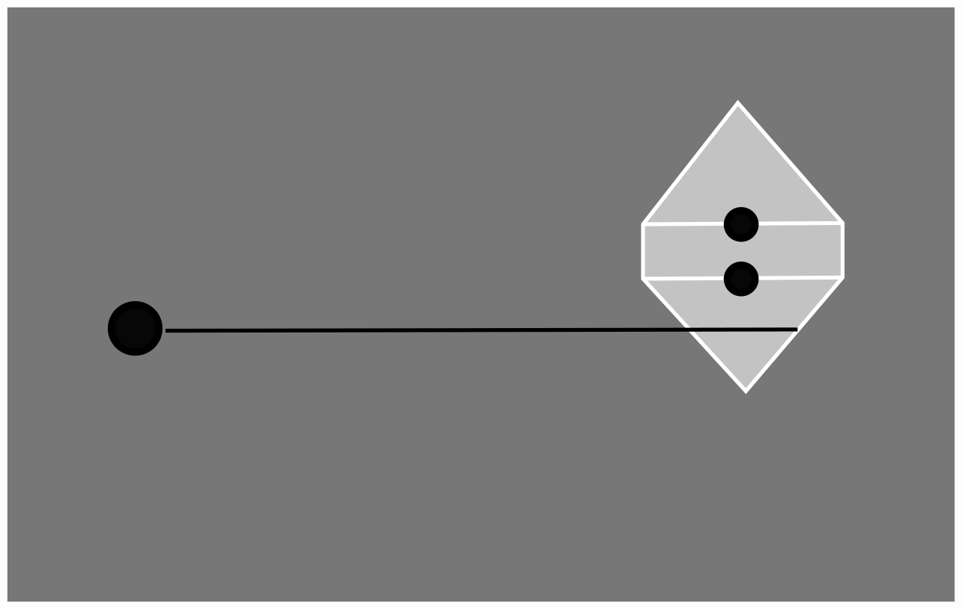
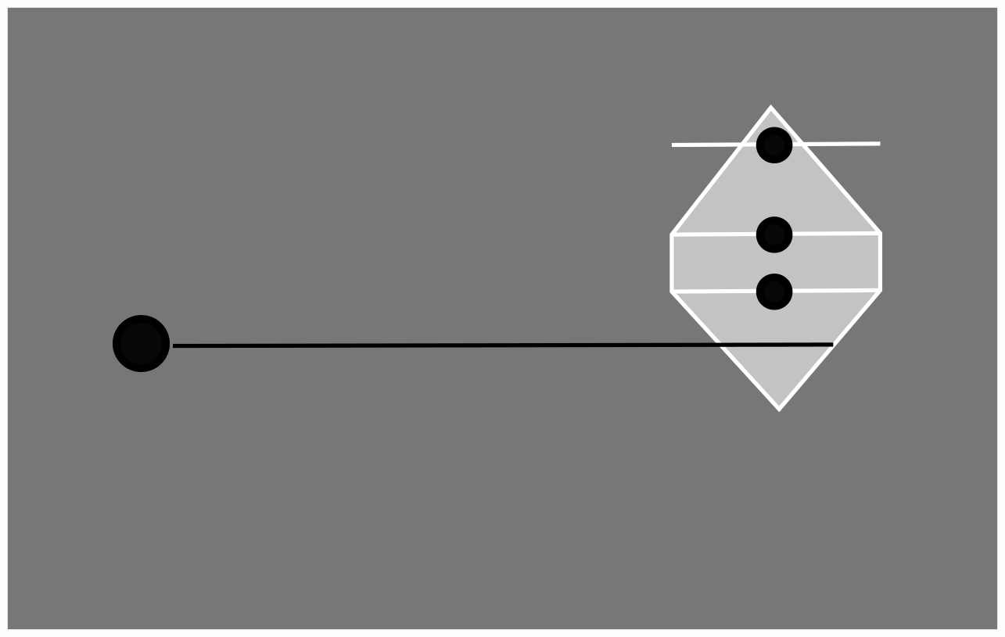
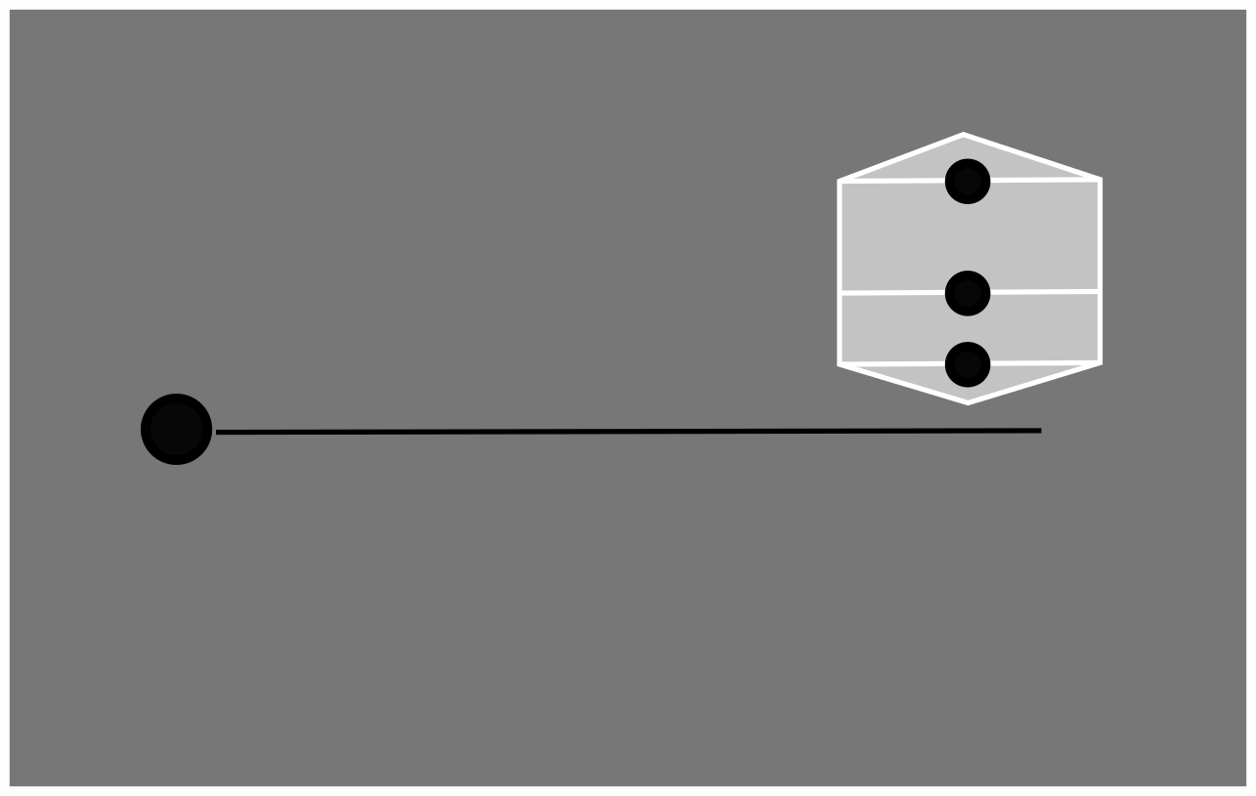
-750 to -500 ms
0 ms
400 - 700 ms
1000 ms
Fixation
Go
Movement started
End Trial
Estimating the probability of a hit
p(in) during one trial
p(in) at t
p(in) at t+1
p(in)
time(s)

Slide 4
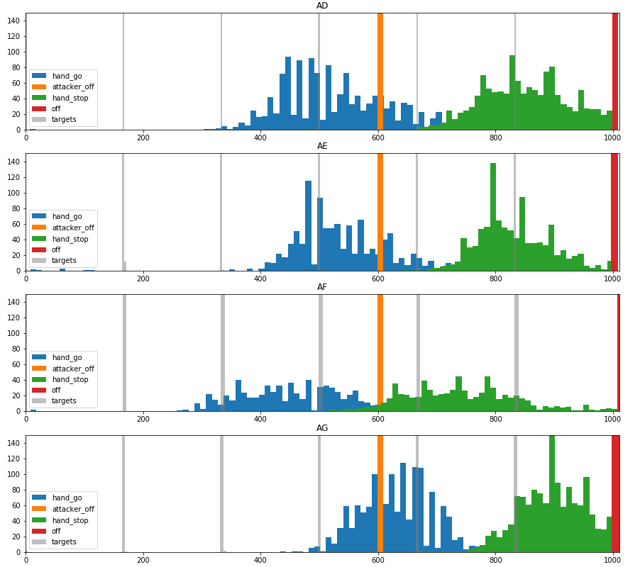
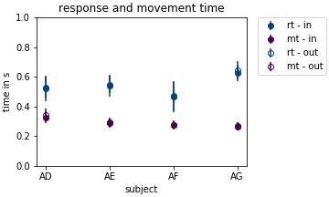
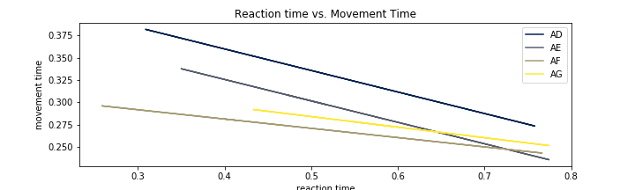
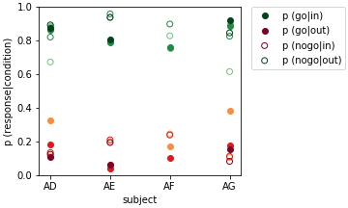
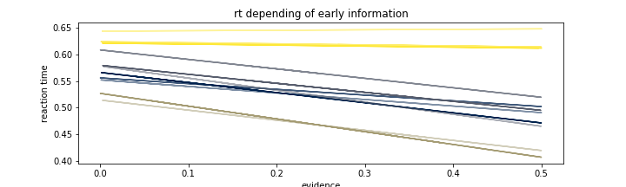
Longer reaction times are correlated with faster movements.
Highly informative targets in the beginning result in quicker responses.
Reaction Time
Normalized p(in)

Slide 5
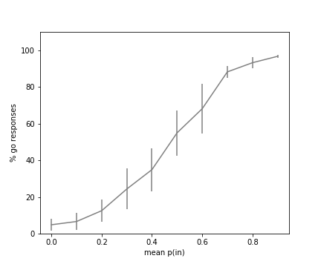
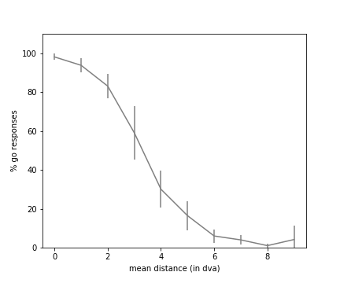
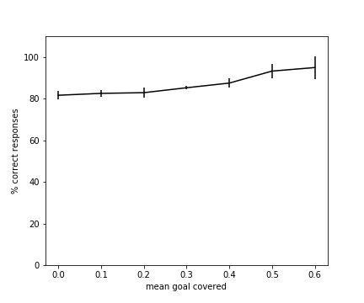
p (in)
Distance target - attacker
Goal cover
The probability of an “in” trial explains the response
So does the distance between the attacker and the targets.

Slide 6
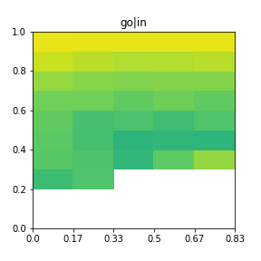
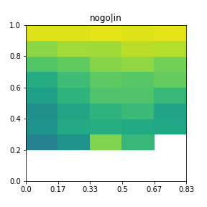
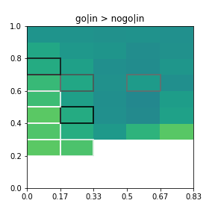

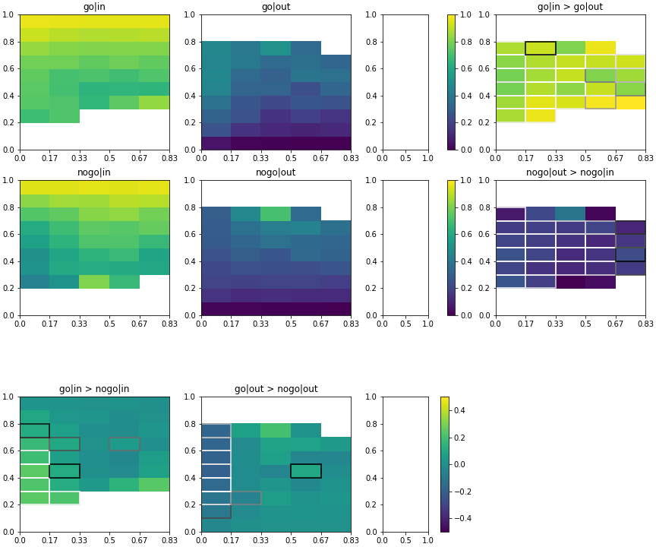
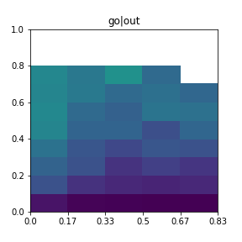
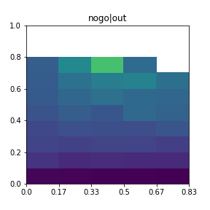
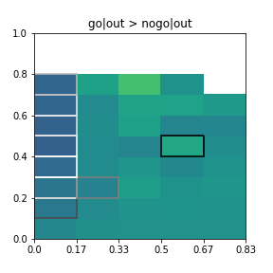
‘Go’ Response
‘No - Go’ Response
Correct > Incorrect
All Trials
‘In’ Trial
Information in the second time window triggered incorrect/correct responses
p(in) at t
‘Out’ Trial
time (s)

Slide 7
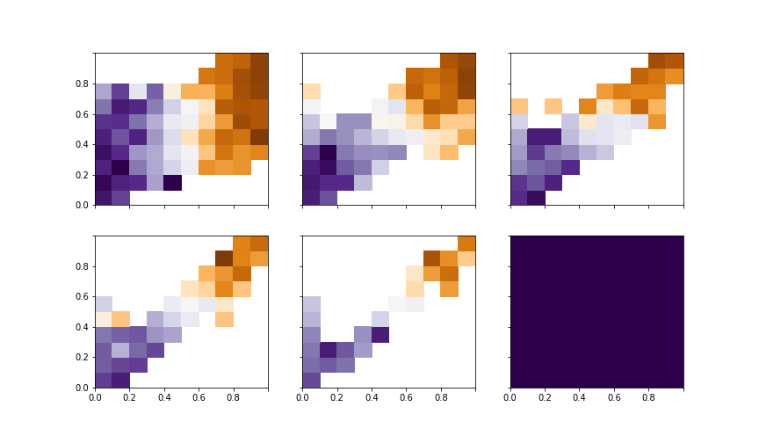
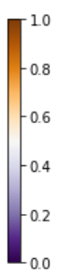
New
1
p(in) at t
Decision based on new information
Decision based on old information
1
1
1
0
p(in) at t+1
1
Information from the second target can be used to update (wrong) believes from the first target.
We don’t have enough data to conclude if early time windows are more relevant for the decision than late time windows.
In -> Out
In -> In
In -> Out
In -> In
In -> Out
In -> In
p(in) at t
p(in) at t
p(in) at t
p(in) at t
Out -> Out
Out -> In
Out -> Out
Out -> In
Out -> Out
Out -> In
Old
1
0
1
0
1
0
1
p(in) at t+1
p(in) at t+1
p(in) at t+1
p(in) at t
p(in) at t+1
0
p(in) at t+1
1

Slide 8
Questions?

Slide 9
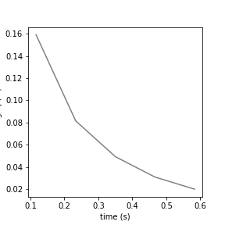
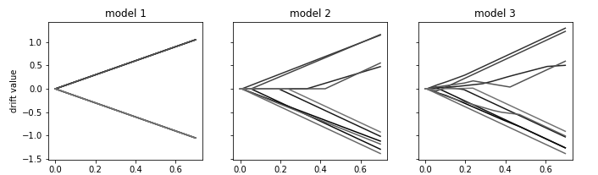
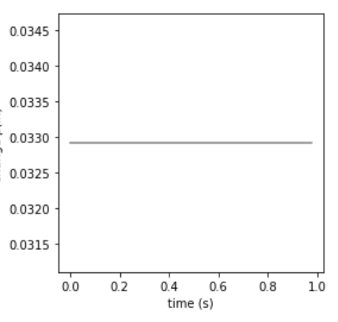
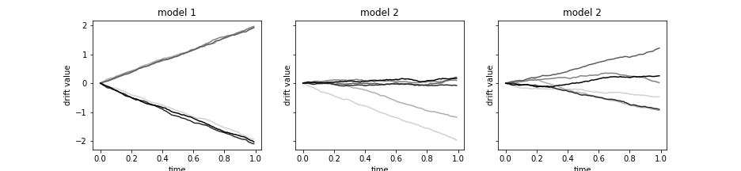
-750 to -500 ms
0 ms
400 - 700 ms
1000 ms
Fixation
Go
Movement started
End Trial
Difference p(in)
Difference p(in)

Slide 10
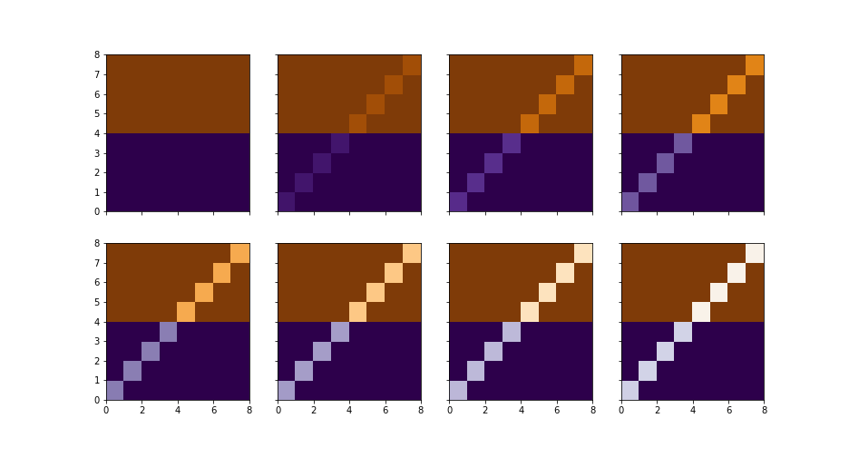
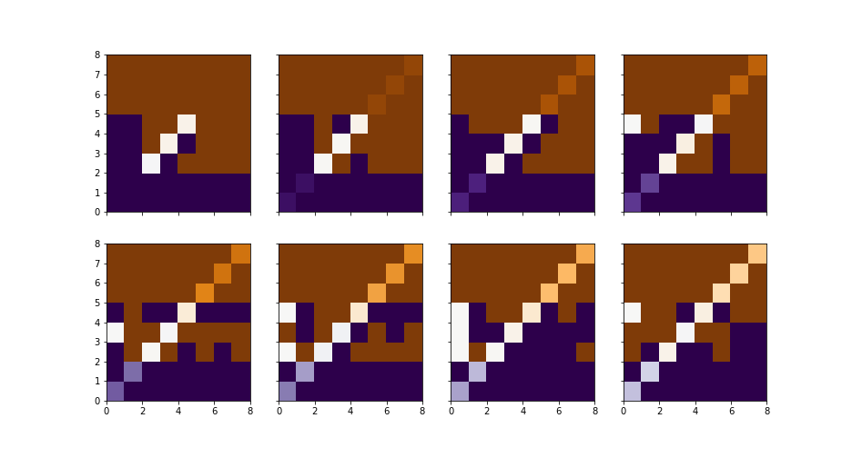
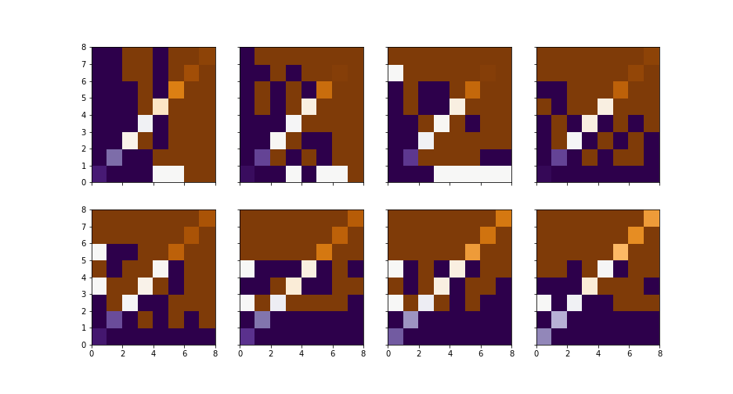
0 - 0.1 s
0.2 - 0.3 s
0.4 - 0.5 s
0.6 - 0.7 s
New
1
Model 1
p(in) at t
0
p(in) at t+1
1
Model 2
p(in) at t
Old
1
Model 3
p(in) at t
0
p(in) at t+1
1
p(in) at t+1

Slide 11
Thank you for your attention!

Slide 13
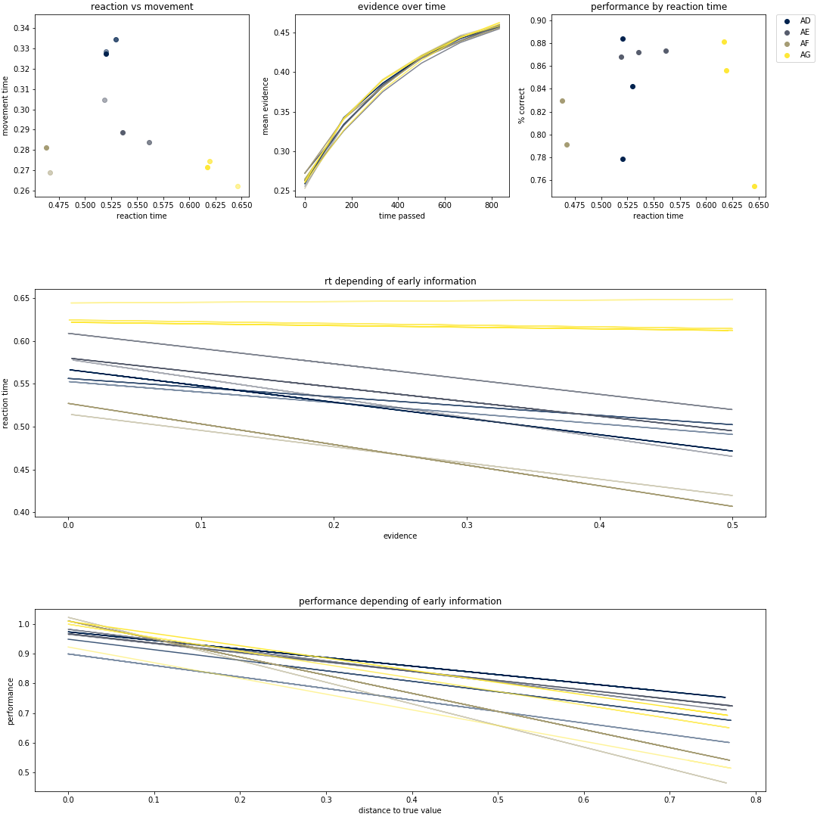

Slide 15
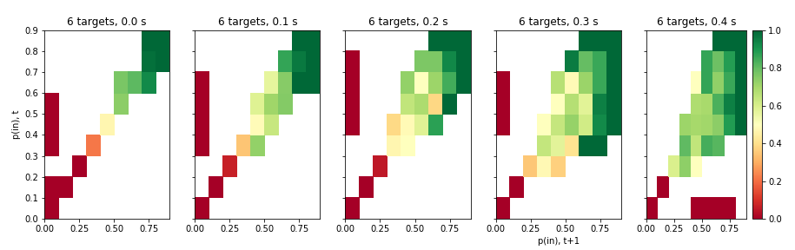

Slide 16
Model 1

Slide 17
Model 2

Slide 18
Model 3

